Slide 1
Computer Security: Principles and Practice
Chapter 18: Security Auditing
EECS710: Information Security
Professor Hossein Saiedian
Fall 2014
Notes:
Lecture slides prepared by Dr Lawrie Brown (UNSW@ADFA) for “Computer Security: Principles and Practice”, 1/e, by William Stallings and Lawrie Brown, Chapter 1 “Overview”.

Slide 2
Security Audit Terminology (RFC 4949)
An independent review and examination of a system's records and activities
  To determine the adequacy of system controls
  To ensure compliance with established security policy and procedures, detect breaches in security services,
  To recommend any changes that are indicated for countermeasures
Objectives: to establish accountability for system entities that initiate or participate in security-relevant events and actions
Notes:
Security auditing is a form of auditing that focuses on the security of an organizations information system (IS) assets. This function is a key element in computer security. Two key concepts are audits and audit trails. This definition of security audit is from RFC2828.

Slide 3
Security Audit Trail (RFC 4949)
A chronological record of system activities that is sufficient to enable the reconstruction and examination of the sequence of environments and activities surrounding or leading to an operation, procedure, or event in a security-relevant transaction from inception to final results
Notes:
This definition of security audit trail is also from RFC2828.

Slide 4
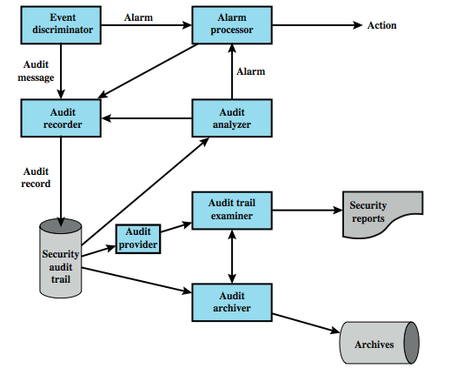
Security Audit Architecture (X.816)
Notes:
ITU-T Recommendation X.816 develops a model, shown in Figure 15.1, that shows the elements of the security auditing function and their relationship to security alarms.
• Event discriminator: logic embedded into the system software that monitors system activity and detects security-related events that it has been configured to detect.
• Audit recorder: event discriminator sends event messages to the audit recorder.
• Alarm processor: some events are alarm events sent to an alarm processor.
• Security audit trail: list of formatted event records
• Audit analyzer: based on a pattern of activity, may define a new auditable event that is sent to the audit recorder and may generate an alarm.
• Audit archiver: extracts records from audit trail to create a permanent archive.
• Archives: a permanent store of security-related events on this system.
• Audit provider: an application and/or user interface to the audit trail.
• Audit trail examiner: an application or user who examines the audit trail and the audit archives for historical trends, for computer forensic purposes / other analysis.
• Security reports: the audit trail examiner prepares human-readable security reports.
This model illustrates the relationship between audit functions and alarm functions. The audit function builds up a record of events that are defined by the security administrator to be security-related. Some of these events may in fact be security violations or suspected security violations. Such events feed into an intrusion detection or firewall function by means of alarms.

Slide 5
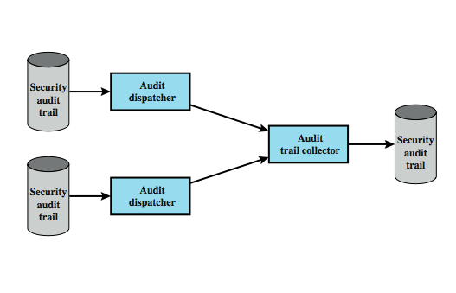
Distributed Audit Trail Model
Notes:
As was the case with intrusion detection, a distributed auditing function in which a centralized repository is created can be useful for distributed systems. Two additional logical components are needed for a distributed auditing service, as shown here in Figure 15.2:
• Audit trail collector: A module on a centralized system that collects audit trail records from other systems and creates a combined audit trail.
• Audit dispatcher: A module that transmits the audit trail records from its local system to the centralized audit trail collector.

Slide 6
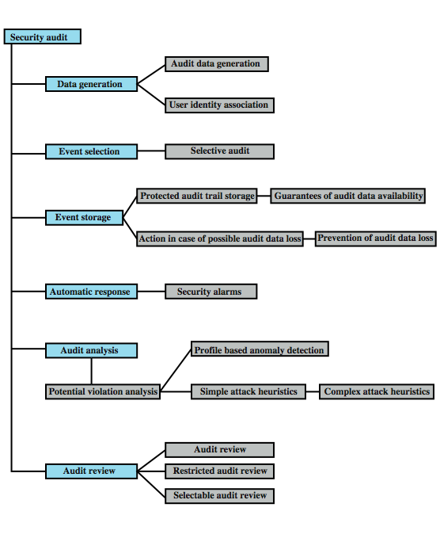
Security Auditing Functions
Notes:
Another breakdown of the security auditing function, is provided by the Common Criteria specification. Figure 15.3 shows a breakdown of security auditing into six major areas, each of which has one or more specific functions:
• Data generation: Identifies the level of auditing, enumerates the types of auditable events, and identifies the minimum set of audit-related information provided.
• Event selection: Inclusion or exclusion of events from the auditable set, allowing different levels of granularity to avoid the creation of an unwieldy audit trail.
• Event storage: Creation and maintenance of the secure audit trail. The storage function includes measures to provide availability and to prevent loss of audit data.
• Automatic response: reactions taken if detect a possible security violation event.
• Audit analysis: automated mechanisms to analyze system activity and audit data in search of security violations. This component identifies the set of auditable events whose occurrence or accumulated occurrence indicate a potential security violation, using anomaly detection and attack heuristics.
• Audit review: available to authorized users to assist in audit data review. The audit review component may include a selectable review function which provides the ability to perform searches based on a single criterion or multiple criteria with logical (i.e. and/or) relations, sort audit data, filter audit data, before audit data are reviewed. Audit review may be restricted to authorized users.

Slide 7
Security Audit Functions
Data generation: Identifies the level of auditing, enumerates the types of auditable events
Event selection: Inclusion or exclusion of events from the auditable set
Event storage: Creation and maintenance of the secure audit trail
Automatic response: reactions taken if detect a possible security violation event
Audit analysis: automated mechanisms to analyze audit data in search of security violations
Audit review: available to authorized users to assist in audit data review

Slide 8
Event Definition: Requirement
Must define what are auditable events
Common Criteria suggests:
  introduction of objects
  deletion of objects
  distribution or revocation of access rights or capabilities
  changes to subject or object security attributes
  policy checks performed by the security software
  use of access rights to bypass a policy check
  use of identification and authentication functions
  security-related actions taken by an operator/user
  import/export of data from/to removable media
Notes:
Reviewing the functionality suggested by Figures 15.1 and 15.3, we can develop a set of requirements for security auditing. The first requirement is event definition. The security administrator must define the set of events the are subject to audit. We go into more detail in the next section, but include here a list suggested in the Common Criteria:
• Introduction of objects within the security-related portion of the software into a subject’s address space
• Deletion of objects
• Distribution or revocation of access rights or capabilities
• Changes to subject or object security attributes
• Policy checks performed by the security software as a result of a request by a subject
• The use of access rights to bypass a policy check
• Use of identification and authentication functions;
• Security-related actions taken by an operator, and/or authorized user (e.g. suppression of a protection mechanism)
• Import/export of data from/to removable media (e.g. printed output, tapes, disks)

Slide 9
Other Audit Requirements
Event detection hooks in software and monitoring software to capture activity
Event recording function with secure storage
Event and audit trail analysis software, tools, and interfaces
Security of the auditing function: data but also software and storage must be protected
Minimal effect on functionality
Notes:
A second requirement is that the appropriate hooks must be available in the application and system software to enable event detection. Monitoring software needs to be added to the system and to appropriate places to capture relevant activity.
Next is needed an event recording function which includes the need to provide for a secure storage resistant to tampering or deletion.
Event and audit trail analysis software, tools, and interfaces are needed to exploit the data collected.
There is an addition requirement for the security of the auditing function. Not only the audit trail, but all of the auditing software and intermediate storage must be protected from bypass or tampering.
Finally, the auditing system should have a minimal effect on functionality.

Slide 10
Implementation Requirements (ISO)
agree on requirements management
scope of checks agreed and controlled
checks limited to read-only access to s/w & data
other access only for isolated copies of system files, then erased or given appropriate protection
resources for performing the checks should be explicitly identified and made available
identify/agreed on special processing requirements
all access should be monitored and logged
document procedures,requirements,responsibilities
person(s) doing audit independent of activities
Notes:
The ISO standard, Code of Practice for Information Security Management (ISO 17799), provides a useful set of guidelines for the implementation of an auditing capability:
1. Audit requirements should be agreed with appropriate management;
2. The scope of the checks should be agreed and controlled;
3. The checks should be limited to read-only access to software and data;
4. Access other than read-only should only be allowed for isolated copies of system files, which should be erased when the audit is completed, or given appropriate protection if there is an obligation to keep such files under audit documentation requirements;
5. Resources for performing the checks should be explicitly identified and made available;
6. Requirements for special or additional processing should be identified and agreed;
7. All access should be monitored and logged to produce a reference trail; the use of timestamped reference trails should be considered for critical data or systems;
8. All procedures, requirements, and responsibilities should be documented;
9. The person(s) carrying out the audit should be independent of the activities audited.

Slide 11
What to Collect
Data items captured may include:
  auditing software use
  use of system security mechanisms
  events from IDS and firewall systems
  system management/operation events
  operating system access (system calls)
  access to selected applications
  remote access
A common concern: the of amount of data generated
Notes:
The choice of data to collect is determined by a number of requirements. One issue is the amount of data to collect, which is determined by the range of areas of interest and by the granularity of data collection. There is a tradeoff here between quantity and efficiency. The more data is collected, the greater the performance penalty on the system. Larger amounts of data may also unnecessarily burden the various algorithms used to examine and analyze the data. Further, the presence of large amounts of data creates a temptation to generate security reports excessive in number or length. With these cautions in mind, the first order of business in security audit trail design is the selection data items to capture. Note that that both normal and abnormal conditions may need to be audited. Auditable events may include:
• Events related to the use of the auditing software
• Events related to the security mechanisms on the system;
• Any events that are collected for use by the various security detection and prevention mechanisms. These include items relevant to intrusion detection and items related to firewall operation
• Events related to system management and operation.
• Operating system access (e.g., via system calls).
• Application access for selected applications.
• Remote access.
Suggested lists of auditable items are specified in X.816, as shown in Table 15.2 in the text; and in ISO17799, as shown in Table 15.3 in the text.

Slide 12
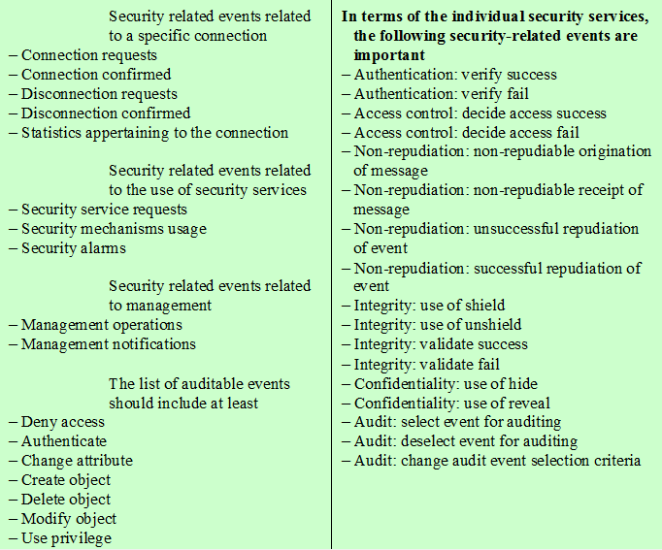
Auditable Items
Suggested in X.816

Slide 13
Examples of System-Level Audit Trails
Useful to categorize audit trails
System-level audit trails:
  Captures logins, device use, O/S functions, e.g.
    Jan 27 17:18:38 host1 login: ROOT LOGIN console
    Jan 27 17:19:37 host1 reboot: rebooted by root
    Jan 28 09:46:53 host1 su: 'su root' succeeded for user1 on /dev/ttyp0
    Jan 28 09:47:35 host1 shutdown: reboot by user1
Notes:
As the security administrator designs an audit data collection policy, it is useful to organize the audit trail into categories for purposes of choosing data items to collect.
System-level audit trails are generally used to monitor and optimize system performance, but can serve a security audit function as well. The system enforces certain aspects of security policy, such as access to the system itself. A system-level audit trail should capture data such as login attempts, both successful and unsuccessful, devices used, and OS functions performed. Other system-level functions may be of interest for auditing, such as system operation and network performance indicators.
Figure 15.4a, from [NITS95], is an example of a system-level audit trail on a UNIX system. The shutdown command terminates all processes and takes the system down to single-user mode. The su command creates a UNIX shell.

Slide 14
Example of Application-Level Audit Trails
To detect security violations within an application
To detect flaws in application's system interaction
For critical/sensitive applications, e.g. email, DB
  email: sender, receiver, email size
  database: queries, table insertion and removal
Record appropriate security related details, e.g.
    Apr 911:20:22 host1 AA06370: from=<user2@host2>, size=3355, class=0
    Apr 911:20:23 host1 AA06370: to=<user1@host1>, delay=00:00:02,stat=Sent
    Apr 911:59:51 host1 AA06436: from=<user4@host3>, size=1424, class=0
    Apr 911:59:52 host1 AA06436: to=<user1@host1>, delay=00:00:02, stat=Sent
Notes:
Application-level audit trails may be used to detect security violations within an application or to detect flaws in the application's interaction with the system. For critical applications, or those that deal with sensitive data, an application-level audit trail can provide the desired level of detail to assess security threats and impacts. For example, for an email application, an audit trail can record sender and receiver, message size, and types of attachments. An audit trail for a database interaction using SQL queries can record the user, type of transaction, and even individual tables, rows, columns, or data items accessed. Figure 15.4b is an example of an application-level audit trail for a mail delivery system.

Slide 15
User-Level Audit Trails
Trace activity of individual users over time
  to hold user accountable for actions taken
  as input to an analysis program that attempts to define normal versus anomalous behavior
May capture
  user interactions with system
    e.g. commands issued
  identification and authentication attempts
  files and resources accessed
  may also log use of applications
Notes:
A user-level audit trail traces the activity of individual users over time. It can be used to hold a user accountable for his or her actions. Such audit trails are also useful as input to an analysis program that attempts to define normal versus anomalous behavior. A user-level audit trail can record user interactions with the system, such as commands issued, identification and authentication attempts, and files and resources accessed. The audit trail can also capture the user's use of applications. Figure 17.4c in the text is an example of a user-level audit trail on a UNIX system.

Slide 16
Physical-Level Audit Trails
Generated by physical access controls
  e.g. card-key systems, alarm systems
Sent to central host for analysis/storage
Can log
  date/time/location/user of access attempt
  both valid and invalid access attempts
  attempts to change access privileges
  may send violation messages to personnel
Notes:
Audit trails can be generated by equipment that controls physical access and then transmitted to a central host for subsequent storage and analysis. Examples are card-key systems and alarm systems. [NIST95] lists the following as examples of the type of data of interest:
• The date and time the access was attempted or made should be logged, as should the gate or door through which the access was attempted or made, and the individual (or user ID) making the attempt to access the gate or door.
• Invalid attempts should be monitored and logged by noncomputer audit trails just as they are for computer-system audit trails. Management should be made aware if someone attempts to gain access during unauthorized hours.
• Logged information should also include attempts to add, modify, or delete physical access privileges (e.g., granting a new employee access to the building or granting transferred employees access to their new office [and, of course, deleting their old access, as applicable]).
• As with system and application audit trails, auditing of noncomputer functions can be implemented to send messages to security personnel indicating valid or invalid attempts to gain access to controlled spaces. In order not to desensitize a guard or monitor, all access should not result in messages being sent to a screen. Only exceptions, such as failed access attempts, should be highlighted to those monitoring access.

Slide 17
Audit Trail Storage Alternatives
Read/write file on host
  easy, least resource use, fast access
  vulnerable to attack by intruder
Write-once device (e.g. CD/DVD-ROM)
  more secure but less convenient
  need media supply and have delayed access
Write-only device (e.g. printer)
  paper-trail but impractical for analysis
Must protect both integrity and confidentiality
  e.g., change pay level, or rank
  using encryption, digital signatures, access controls
Notes:
RFC 2196 (Site Security Handbook) lists three alternatives for storing audit records:
• Read/write file on a host: relatively easy to configure and least resource intensive. Records can be accessed instantly, which is useful for countering an ongoing attack. However, this approach is highly vulnerable if an attacker gains privileged access to a system, then the audit trail may be modified or deleted.
• Write-once/read-many device (e.g., CD-ROM or DVD-ROM): far more secure but less convenient. Need a steady supply of recordable media. Access may be delayed.
• Write-only device (e.g., a line printer): do provide a paper trail, useful when a permanent, immediately available log is required, but are impractical for capturing detailed audit data on large systems or networked systems.
Protection of the audit trail involves both integrity and confidentiality. Integrity is particularly important because an intruder may attempt to remove evidence of the intrusion by altering the audit trail. For file system logging, perhaps the best way to ensure integrity is the digital signature. Write-once devices, such as CD-ROM or paper, automatically provide integrity. Strong access control is another measure to provide integrity. Confidentiality is important if the audit trail contains user information that is sensitive and should not be disclosed to all users, such as information about changes in a salary or pay grade status. Strong access control helps in this regard. An effective measure is symmetric encryption (e.g., using AES or triple DES). The secret key must be protected and only available to the audit trail software and subsequent audit analysis software.

Slide 18
Implementing Logging
Foundation of security auditing facility is the initial capture of the audit data
Software must include hooks (capture points) that trigger data collection and storage as preselected events occur
Operating system/application dependent
Notes:
The foundation of a security auditing facility is the initial capture of the audit data. This requires that the software include hooks, or capture points, that trigger the collection and storage of data as preselected events occur. Such an audit collection or logging function is dependent on the nature of the software and will vary depending on the underlying operating system and the applications involved. In this section, we look at approaches to implementing the logging function for system-level and user-level audit trails on the one hand and application-level audit trails on the other. Much of the logging at the system level can be implemented using existing facilities that are part of the operating system. We now consider the facility in the Windows operating system and then the syslog facility found in UNIX operating systems.

Slide 19
Windows Event Log
Each event an entity that describes some interesting occurrence and
  each event record contains: numeric id, set of attributes, optional user data
  Presented as XML or binary data
Three types of event logs:
  system: system related apps & drivers
  application: user-level apps
  security: for Local Sec Authority (LSA) only
Notes:
An event in Windows Event Log is an entity that describes some interesting occurrence in a computer system. Events contain a numeric identification code, a set of attributes (task, opcode, level, version, and keywords), and optional user-supplied data. The event information and attributes delivered by publishers is represented to event consumers as XML data or binary data. Windows is equipped with three types of event logs:
• System event log: Used by applications running under system service accounts (installed system services), drivers, or a component or application that has events that relate to the health of the computer system.
• Application event log: Events for all user-level applications. This log is not secured and it is open to any applications. Applications that log extensive information should define an application-specific log.
• Security event log: The Windows Audit Log. This event log is for exclusive use of the Windows Local Security Authority. User events may appear as audits if supported by the underlying application.
For all of the event logs, or audit trails, event information can be stored in an XML format. Table 15.4 in the text lists the items of information stored for each event.

Slide 20
Windows Event Log Example
Event Type: Success Audit
Event Source: Security Event
Category: (1)
Event ID: 517
Date: 3/6/2006
Time: 2:56:40 PM
User: NT AUTHORITY\SYSTEM
Computer: KENT
Description: The audit log was cleared
Primary User Name: SYSTEM
Primary Domain: NT AUTHORITY
Primary Logon ID: (0x0,0x3F7)
Client User Name: userk
Client Domain: KENT
Client Logon ID: (0x0,0x28BFD)
Notes:
Figure 15.5 from the text, shown here, is an example of data exported from a Windows system event log.

Slide 21
Windows Event Categories
Account logon events: acceptance/rejection of authentication
Account management: account creation/deletion
Directory service access: user access to active dir (that has a system access control defined)
Logon events: user log in/log off, bad password
Object access: same as DSL but to registry and similar
Policy changes: admin changes to access policies
Privilege use: user right changes
Process tracking: start and termination
System events: start, reboot, shut down
Notes:
Windows allows the system user to enable auditing in nine different categories:
• Account logon events: records user authentication activity from the perspective of the system that validated the attempt.
• Account management: records administrative activity related to the creation, management, and deletion of individual accounts and user groups.
• Directory service access: records user-level access to any Active Directory object that has a System Access Control List defined.
• Logon events: records user authentication activity, either to a local machine or over a network, from the system that originated the activity.
• Object access: records user-level access to file system and registry objects that have System Access Control Lists defined. Provides a relatively easy way to track read access, as well as changes, to sensitive files, integrated with the operating system.
• Policy changes: records administrative changes to the access policies, audit configuration, and other system-level settings.
• Privilege use: records all instances of users exercising access to particular system functions (creating objects, debugging executable code, or backing up the system).
• Process tracking: records detailed audit information when processes start and finish, programs are activated, or objects are accessed indirectly.
• System events: records information on events that affect the availability and integrity of the system, including boot messages and the system shutdown message.

Slide 22
UNIX Syslog
UNIX's general-purpose logging mechanism
  Found on all UNIX/Linux variants
  But with variants in facility and log format
Elements:
  syslog() API
  /etc/syslog.conf configuration file
  syslogd daemon to receive/route log events
Notes:
Syslog is UNIX's general-purpose logging mechanism found on all UNIX variants and Linux. Different UNIX implementations will have different variants of the syslog facility and there are no uniform system log formats across systems. Here, we provide a brief overview of some syslog-related functions and look at the syslog protocol. The syslog facility consists of the following elements:
• syslog(): an application program interface (API) referenced by several standard system utilities and available to application programs
• logger: a UNIX command used to add single-line entries to the system log
• /etc/syslog.conf: the configuration file used to control the logging and routing of system log events
• syslogd: the system daemon used to receive and route system log events from syslog() calls and logger commands.

Slide 23
Syslog Service
basic service provides:
  a means of capturing relevant events
  a storage facility
  a protocol for transmitting syslog messages from other hosts to a central syslog server
extra add-on features may include:
  robust filtering, log analysis, event response, alternative message formats, log file encryption, database storage, rate limiting
Notes:
The basic service offered by UNIX syslog is a means of capturing relevant events, a storage facility, and a protocol for transmitting syslog messages from other machines to a central machine the acts as a syslog server. In addition to these basic functions, other services are available, often as third-part packages or built-in modulesproviding:
• Robust filtering: such as handling messages differently based on host or program that generated a message, or a regular expression matching content in message body.
• Log analysis: limited log analysis capabilities, such as correlating multiple log items
• Event response: initiate actions when certain events are detected.
• Alternative message formats: accept data in non-syslog formats, e.g. SNMP traps.
• Log file encryption: of rotated log files automatically, protecting confidentiality.
• Database storage for logs: to store log entries in both traditional syslog files and a database, which is very helpful for subsequent log analysis.
• Rate limiting: on number of syslog messages or TCP connections from a particular source during a certain period of time.

Slide 24
Syslog Protocol
a transport allowing hosts to send IP event notification messages to syslog servers
  provides a very general message format
  allowing processes / apps to use suitable conventions for their logged events
common BSD (RFC3164) version has:
  PRI - facilities / severity code
  header - timestamp & hostname/IP address
  message - program name and content
Notes:
The syslog protocol provides a transport to allow a machine to send event notification messages across IP networks to event message collectors - also known as syslog servers. Within a system, we can view the process of capturing and recording events in terms of various applications and system facilities sending messages to syslogd for storage in the system log. Because each process, application, and UNIX OS implementation may have different formatting conventions for logged events, the syslog protocol provides only a very general message format for transmission between systems.
A common version of the syslog protocol was originally developed on the University of California Berkeley Software Distribution (BSD) UNIX/TCP/IP system implementations. This version is documented in RFC 3164, The BSD syslog Protocol. Messages in this format consist of three parts:
• PRI: Consists of a code that represents the Facilities and Severity values of the message, described subsequently.
• Header: contains a timestamp and indication of hostname or IP address of device.
• Msg: consists of two fields: the TAG field is the name of the program or process that generated the message; the CONTENT contains the details of the message. The Msg part has traditionally been a freeform message of printable characters that gives some detailed information of the event.

Slide 25
Syslog Examples
Mar 1 06:25:43 server1 sshd[23170]: Accepted publickey for server2 from 172.30.128.115 port 21011 ssh2
Mar 1 07:16:42 server1 sshd[9326]: Accepted password for murugiah from 10.20.30.108 port 1070 ssh2
Mar 1 07:16:53 server1 sshd[22938]: reverse mapping checking getaddrinfo for ip10.165.nist.gov failed - POSSIBLE BREAKIN ATTEMPT!
Mar 1 07:26:28 server1 sshd[22572]: Accepted publickey for server2 from 172.30.128.115 port 30606 ssh2
Mar 1 07:28:33 server1 su: BAD SU kkent to root on /dev/ttyp2
Mar 1 07:28:41 server1 su: kkent to root on /dev/ttyp2
Notes:
Figure 15.6 from the text shows several examples of syslog messages

Slide 26
Syslog Facility and Severity
facility identifies application / system component that generates the message:
  user kern mail daemon auth lpr news uucp cron local0-7 mark
severity (message level) indicates the relative severity of the message
  can be used for some rudimentary filtering
  emerg alert crit err warning notice info debug
Notes:
All messages sent to syslogd have a facility and a severity, as shown in Table 15.5 in the text (and summarized here). The facility identifies the application or system component that generates the message. The severity, or message level, indicates the relative severity of the message and can be used for some rudimentary filtering.

Slide 27
Logging at Application Level
Privileged applications have security issues
  which system/user-level audit data may not see
  a large percentage of reported vulnerabilities
  e.g. failure to adequately check input data (that lead to buffer overflow)
Hence need to capture detailed behavior
Notes:
Applications, especially applications with a certain level of privilege, present security problems that may not be captured by system-level or user-level auditing data. Application-level vulnerabilities constitute a large percentage of reported vulnerabilities on security mailing lists. One type of vulnerability that can be exploited is the all-too-frequent lack of dynamic checks on input data, which make possible buffer overflow (see Chapter 11) and format string attacks. Other vulnerabilities exploit errors in application logic. For example, a privileged application may be designed to read and print a specific file. An error in the application might allow an attacker to exploit an unexpected interaction with the shell environment to force the application to read and print a different file that would result in a security compromise.
Auditing at the system level does not provide the level of detail to catch application logic error behavior. Further, intrusion detection systems look for attack signatures or anomalous behavior that would fail to appear with attacks based on application logic errors. For both detection and auditing purposes, it may be necessary to capture in detail the behavior of an application, beyond its access to system services and file systems. The information needed to detect application-level attacks may be missing or too difficult to extract from the low-level information included in system call traces and in the audit records produced by the operating system.
Whilst an application can obviously be coded to explicitly create suitable audit records, there is an issue with applications which do not do this. We examine two approaches to collecting audit data from such applications: interposable libraries and dynamic binary rewriting.

Slide 28
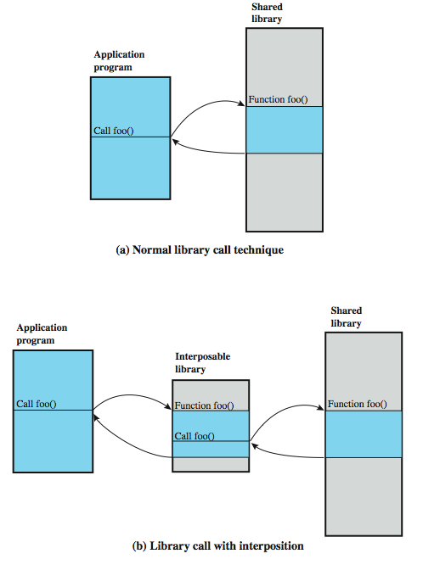
Interposable Libraries
Intercept calls to shared 100s of library functions; can carry out audit related functions
Notes:
One technique provides for application-level auditing by creating new procedures that intercept calls to shared library functions in order to instrument the activity. This approach can be used on any UNIX or Linux variant and on some other operating systems, and exploits the use of dynamic libraries in UNIX.
Figure 15.7a indicates the normal mode of operation when an program invokes a routine in a dynamically-linked shared libraries. At load time, the reference to routine foo in the program is resolved to the virtual memory address of the start of the foo in the shared library.
With library interpolation, a special interposable library is constructed so that at load time, the program links to the interposable library instead of the shared library. For each function in the shared library for which auditing is to be invoked, the interposable library contains a function with the same name. If the desired function is not contained in the interposed library, the loader continues its search in the shared library and links directly with the target function. The interposed module can perform any auditing-related function, such as recording the fact of the call, the parameters passed and returned, the return address in the calling program, and so forth. Typically, the interposed module will call the actual shared function (Figure 15.7b) so that the application's behavior is not altered, just instrumented. This technique allows the interception of certain function calls and the storage of state between such calls without requiring the recompilation of the calling program or shared objects.
The interposition technique is designed to work with dynamically-linked shared libraries. It cannot intercept function calls of statically-linked programs unless all programs in the system are relinked at the time that the audit library is introduced.

Slide 29
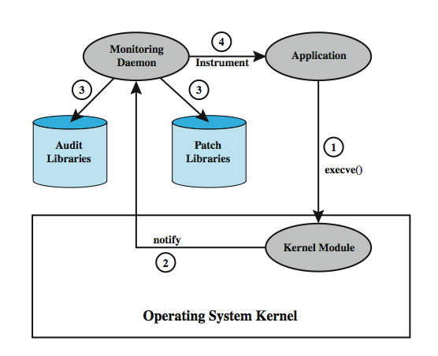
Dynamic Binary Rewriting
Notes:
Dynamic binary rewriting is a post-compilation technique that directly changes the binary code of executables, and hence can be used with both statically- and dynamically-linked programs. The change is made at load time and modifies only the memory image of a program, not the binary program file on secondary storage. Audit module selection is postponed until the application is invoked.
The technique is implemented on Linux using two modules: a loadable kernel module and a monitoring daemon. Figure 15.9 shows the structure of this approach. The kernel module ensures non-bypassable instrumentation by intercepting the execve() system call that loads a new executable into a new process address space and begins executing it. The actual instrumentation of an application is performed by the monitoring daemon, which is a privileged user-space process. The daemon manages two repositories: a patch repository and an audit repository. The patch repository contains the code for instrumenting the monitored applications. The audit repository contains the auditing code to be inserted into an application. The code in both the audit and the patch repositories is in the form of dynamic libraries. By using dynamic libraries, it is possible to update the code in the libraries while the daemon is still running. In addition, multiple versions of the libraries can exist at the same time. The sequence of events is as follows:
1. A monitored application is invoked by the execve() system call.
2. The kernel module intercepts the call, & notifies the user-space daemon.
3. The daemon loads the audit library functions into the application's address space.
4. Once the application is instrumented, the daemon enables its execution.

Slide 30
Audit Trail Analysis
Analysis programs/procedures vary widely
  cf. NIST SP 800-92 provide guidelines
Must understand context of log entries
  relevant info in same / other logs, config
  possibility f unreliable entries
Audit file formats mix of plain text / codes
  hence must decipher manually / automatically
Ideally regularly review entries to gain understanding of baseline
Notes:
Programs and procedures for audit trail analysis vary widely, depending on the system configuration, the areas of most concern, the software available, the security policy of the organization, and the behavior patterns of legitimate users and intruders. To perform useful audit analysis, the analyst or security administrator needs an understanding of the information available and how it can be used. NIST SP 800-92 offers some useful advice in this regard.
The security administrator needs to understand the context surrounding individual log entries. Relevant information may reside in other entries in the same log, in other logs, and non-log sources such as configuration management entries. The administrator should understand the potential for unreliable entries, such as from a security package that is known to generate frequent false positives when looking for malicious activity.
Most audit file formats contain a mixture of plain language plus cryptic messages or codes that are meaningful to the software vendor but not necessarily to the administrator. The administrator must make the effort to decipher as much as possible the information contained in the log entries. In some cases, log analysis software performs a data reduction task that reduces the burden on the administrator. Still, the administrator should have a reasonable understanding of the raw data that feeds into analysis and review software in order to be able to assess the utility of these packages.
The most effective way to gain a solid understanding of log data is to review and analyze portions of it regularly (e.g., every day). The goal is to eventually gain an understanding of the baseline of typical log entries, likely encompassing the vast majority of log entries on the system.

Slide 31
Types of Audit Trail Analysis
Audit trails can be used in multiple ways
Possibilities include:
  Audit trail review after an event
    triggered by event to diagnose cause & remediate
  Periodic review of audit trail data
    review bulk data to identify a pattern that suggests problem
  Real-time audit analysis
    as part of an intrusion detection function
Notes:
Audit trails can be used in multiple ways. The type of analysis depends, at least in part, on when the analysis is to be done. The possibilities include:
• Audit trail review after an event: This type of review is triggered by an observed event, such as a known system or application software problem, a known violation of existing security policy by a user, or some unexplained system or user problem. The review can gather information to elaborate on what is know about the event, to diagnose the cause or the problem, and to suggest remedial action and future countermeasures. This type of review focuses on the audit trail entries that are relevant to the specific event.
• Periodic review of audit trail data: This type of review looks at all of the audit trail data or at defined subsets of the data, and has many possible objectives. Examples of objectives include looking for events or patterns that suggest a security problem, developing a profile of normal behavior and searching for anomalous behavior, and developing profiles by individual user to maintain a permanent record by user.
• Real-time audit analysis: Audit analysis tools can also be used in a real-time, or near real-time fashion. Real-time analysis is part of the intrusion detection function.

Slide 32
Audit Review: Specific Purpose
Audit review capability provides admin with information from selected audit records
  actions of one or more users
  actions on a specific object or resource
  all or a specified set of audited exceptions
  actions on a specific system / security attribute
May be filtered by time / source / freq etc
Notes:
Distinct from an analysis of audit trail data using data reduction and analysis tools is the concept of audit review. An audit review capability enables an administrator to read information from selected audit records. The Common Criteria specification [CCPS04] calls for a capability that allows pre-storage or post-storage audit selection and includes the ability to selectively review the following:
• the actions of one or more users (e.g. identification, authentication, system entry, and access control actions)
• the actions performed on a specific object or system resource
• all or a specified set of audited exceptions
• actions associated with a specific system or security attribute
Audit review can be focused on records that match certain attributes, such as user or user group, time window, type of record, and do forth. One automated tool that can be useful in audit review is a prioritization of audit records based on input from the administrator. Records can be prioritized based on a combination of factors, as noted in the text. There may be a number of possible purposes for this type of audit review. Audit review can enable an administrator to get a feel for the current operation of the system and the profile of the users and applications on the system, the level of attack activity, and other usage and security-related events. Audit review can be used to gain an understanding after the fact of an attack incident and the system's response to it, leading to changes in software and procedures.

Slide 33
Approaches to Data Analysis
Basic alerting (simplest)
  indicates interesting type of event has occurred
Baselining (anomaly detection)
  define normal vs unusual events/patterns
  anomaly detection
  thresholding (e.g., # of refused connections)
Windowing
  of events within a set of parameters (e.g., time)
Correlation
  seek relationships among events
Notes:
Some of the major approaches are:
Basic Alerting is he simplest form of an analysis that gives an indication that a particular interesting event has occurred. If the indication is given in real time, it can serve as part of an intrusion detection system. Alternatively, an after-the-fact indication of suspicious activity can lead to further analysis.
Baselining is the process of defining normal versus unusual events and patterns. The process involves measuring a set of known data to compute a range of normal values. These baseline values can them be compared to new data to detect unusual shifts. One approached, discussed frequently in this book, is anomaly detection. Another form of baseline analysis is thresholding, which is the identification of data that exceeds a particular baseline value, and is used to identify events, such as refused connections, that happen more than a certain number of times.
Windowing is detection of events within a given set of parameters, such as within a given time period or outside a given time period—for example, baselining the time of day each user logs in and flagging logins that fall outside that range.
Correlation seeks for relationships among events. A simple instance of correlation is, given the presence of one particular log message, to alert on the presence of a second particular message.

Slide 34
Integrated Approaches
volume of audit data mean manual analysis and baselining is impractical
need a Security Information and Event Management (SIEM) system
  a centralized logging and analysis package
  agentless (no special SW on host) or agent-based (special SW filters event data)
  normalizes a variety of log formats
  analyzes combined data
  correlates events among the log entries
  identifies and prioritizes significant events
  can initiate responses
Notes:
A security officer needs to be able to characterize normal activity and thresholds so that the system will generate alerts when anomalies or malicious patterns are detected. Because of the volume of data, a human-generated or even human-assisted baseline generation was impractical. And with the broad mix of audit data sources and formats, there seemed to be no obvious way to develop automated baseline generation.
Need a Security Information Management (SIM) system or a Security Information and Event Management (SIEM) system, which is a centralized logging software package. SIEM systems provide a centralized, uniform audit trail storage facility and a suite of audit data analysis programs. There are two general configuration approaches:
• Agentless: SIEM server receives data from the individual log generating hosts without needing to have any special software installed on those hosts. The SIEM server then performs event filtering and aggregation and log normalization and analysis on the collected logs.
• Agent-based: an agent program is installed on the log generating host to perform event filtering and aggregation and log normalization for a particular type of log, then transmit the normalized log data to an SIEM server.
SIEM software is able to recognize a variety of log formats, including those from a variety of OSs, security software, application servers, and even physical security control devices. The SIEM software normalizes these various log entries so that the same format is used for the same data item in all entries. The SIEM server analyzes the combined data, correlates events among the log entries, identifies and prioritizes significant events, and can initiate responses to events.

Slide 35
Example: Cisco MARS
More elaborate than syslog
Support a wide variety of systems
Agentless with central dedicated server
Wide array of analysis packages
An effective GUI
Server collects, parses, normalizes, correlates and assesses events to then check for false positives, vulnerabilities, and profiling
Notes:
The Cisco Systems' MARS product is an example of a SIEM product that supports a variety of systems, including of course all Cisco routers, firewalls, switches, concentrators, IDSs, etc. In addition, MARS can pull data from almost any SNMP- and syslog-enabled device, as well as from a wide range of vulnerability and antivirus systems, host operating systems, Web servers, Web proxy devices, and database servers. MARS works in an agentless configuration, with a centralized dedicated server. MARS provides a wide array of analysis packages and an effective graphical user interface (GUI). Preliminary indications are that this product will meet the needs of the security officer. In general terms the server performs the following steps:
1. Events come to MARS server from devices and software modules on network.
2. Events are parsed to locate and identify each field in the entry
3. MARS normalizes each entry into a uniform audit trail entry format
4. MARS correlates them to find events that are related and defines sessions.
5. Sessions and uncorrelated events are run against a rule engine and each is assessed. Some events and sessions are dropped as irrelevant. The others are reclassified as incidents to be logged in the incident database.
6. A false-positive analysis is run on the data to catch known false positive reports for IDS and other systems in the network
7. A vulnerability assessment is performed against suspected hosts to determine the urgency of the data.
8. Traffic profiling and statistical anomaly detection programs are run against the data.

Slide 36
Summary
Introduced need for security auditing
Audit model, functions, requirements
Security audit trails
Implementing logging
Audit trail analysis
Integrated SIEM products
Notes:
Chapter 15 summary.

